Slide 2
Software Defined Infrastructure
An overview of where we are going

Slide 3
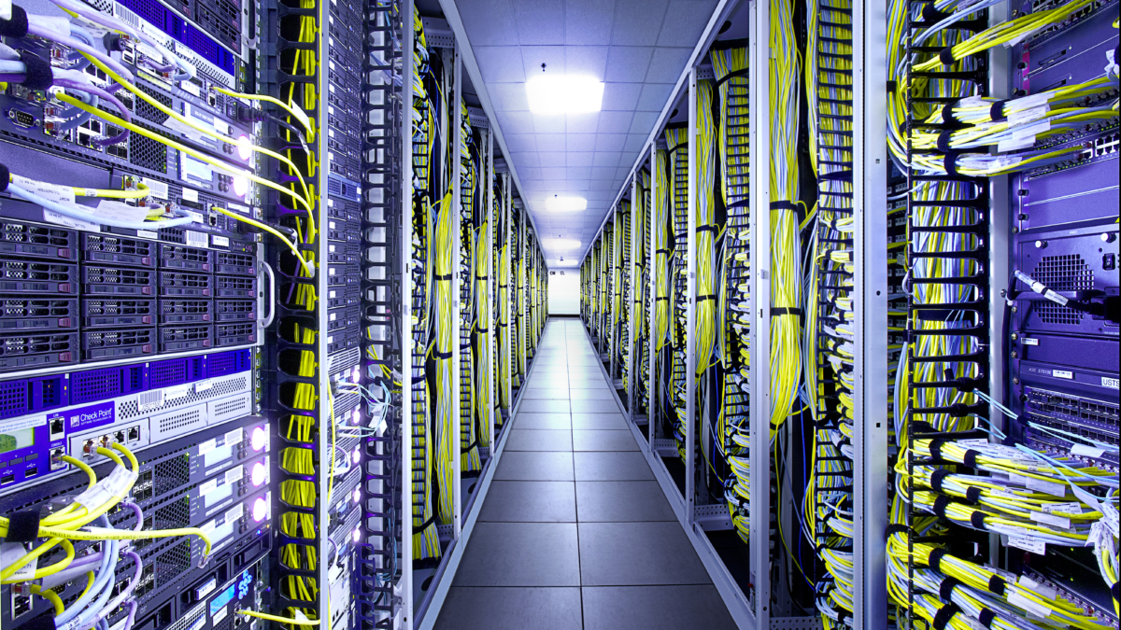
Systems & Equipment

Slide 4
Systems & Equipment – Where are we going?
What we want
Simple
Secure
Low cost
Easy to maintain
Easy to support
Enables 24 x 365 operations
Cloud enabled
Monitored
Highly available

Slide 5
Systems & Equipment – Where are we going?
Simplification of physical infrastructure
Move burden of some of the infrastructure to container land
Use software defined infrastructure (load balancer, reverse proxy, network segmentation, …)
We get service discovery!
Desired State Configuration
Stability & higher rate of change
Automation through composable systems
Greater level of automated infrastructure testing to ensure greater quality and hence stability
Greater availability
Design our system components to be redundant
Use container orchestration to handle failover, rolling upgrades, scaling out
Greater ability to change
System changes that can occur during the day
Reduce or eliminate the need for maintenance windows
Reduce patching of operating systems
Support better upgrade capabilities of components

Slide 6

Software Defined Infrastructure

Slide 7
Where Could It Fit?
Firewall
Physical infrastructure at the boundary
Continues to provide protection
SDI used internally
SDI partitioned by physical devices
Services SDI
DMZ
SDI
Concord Physical Infrastructure

Slide 8
Environment Being Used
Docker swarm acting as SDI
Uses 3 machines
Docker03
Docker04
Docker09
Acts as a single cohesive unit
Can survive the loss of one node
3 managers loss of 1
5 managers loss of 2
Requires quorum voting (n/2 + 1)
Swarm
docker03
docker04
docker09
docker node ls

Slide 9
SDI – Seg1
group1_net
Single network
Called group1_net
3 services
Single container per service
Simulates a three tier application
Demonstrate
Single instance of each container
Network spans all nodes in swarm
Containers running across multiple nodes in Swarm
Service discovery between containers on same network
frontend1
middle1
backend1
docker stack deploy --compose-file seg1.yml jon
docker stack ps jon
docker service ls
docker network ls
docker service exec –it jon_backend1 /bin/sh

Slide 10
SDI – Seg2
group1_net
group2_net
frontend1
middle1
backend1
frontend2
middle2
backend2
docker stack deploy --compose-file seg2.yml jon
docker network ls
docker stack ps jon
docker exec –it jon_frontend1…. /bin/sh
Two networks
Called group1_net, group2_net
Each running 3 services with a single container in each service
Demonstrate
Services running in one network cannot see services in the other

Slide 11
SDI – Seg3
bridge
group1_net
group2_net
frontend1
middle1
backend1
frontend2
middle2
backend2
Demonstrate
Add a service with a single container that is a member of both networks
Bridge service can see all other services
docker stack deploy --compose-file seg3.yml jon

Slide 12
SDI – Seg4
frontend_net
frontend1
3 networks
Represents a layered network
Only certain parts of an application are able to communicate with other parts
middle_net
middle1
backend_net
backend1
docker stack rm jon
docker stack deploy --compose-file seg4.yml jon
docker network ls
docker stack ps jon

Slide 13
SDI – Seg5
group1_net
group1_net
frontend1
middle1
backend1
frontend1
middle1
backend1
Environment DEV
Environment QA
Demonstrate
Creating environments using single template
1 Environment called DEV
1 Environment called QA
Each environment is separate and cannot interact at a network level
docker stack rm jon
docker stack deploy --compose-file seg1.yml dev
docker stack deploy --compose-file seg1.yml qa

Slide 14
SDI – LB1
Single network
Called group1_net
3 services
3 containers per service
Demonstrate
Load balancer in front of each service
group1_net
LB
LB
LB
frontend1
middle1
backend1
frontend1
middle1
backend1
docker stack rm dev
docker stack rm qa
docker stack deploy --compose-file lb1.yml jon
docker service ls
docker stack ps jon
frontend1
middle1
backend1

Slide 15
SDI – Ingres1
Single network
Called group1_net
3 services
2 containers in frontend service
Single container in other services
Demonstrate
Map outside port to inside port
Load balancer from outside
Ingres from any swarm node
LAN
Port 8080
Swarm
group1_net
LB
frontend1
middle1
backend1
Port 80
frontend1
docker stack rm jon
docker stack deploy --compose-file ingres1.yml jon
docker service ls
docker service ps jon_frontend…

Slide 16
SDI – Scale1
group1_net
frontend1
middle1
backend1
frontend1
docker service scale jon_frontend1=10
docker service ls
docker service scale jon_frontend1=3
docker service ls
Single network
Called group1_net
3 services
2 containers in frontend service
Single container in other services
Demonstrate
Scale frontend service up to 10 containers
Scale frontend service down to 3 containers

Slide 17
SDI – Rolling1
group1_net
Single network
Called group1_net
3 services
3 containers for frontend service
Single container for other services
Demonstrate
Upgrade the frontend service using a rolling upgrade
Selects a single container and stops old version and starts a new version
Waits to ensure stability then moves onto to next container
Can control number of services to update, delay between update, etc
frontend1
middle1
backend1
frontend1
frontend1
docker service ps jon_frontend1
docker service update --image joncatlin/nginx-demo:2.0 jon_frontend1
docker service ls

Slide 18

QUESTIONS

Slide 19
Questions
?

Slide 21
SDI – Seg6
group1_net
group2_net
frontend1
middle1
backend1
frontend2
middle2
backend2
docker stack deploy --compose-file seg6.yml jon
docker network ls
docker stack ps jon
docker exec –it jon_frontend1…. /bin/sh
Two networks
Called group1_net, group2_net
Each running 3 services with a single container in each service
Demonstrate
Group1_net has egress access
Group2_net does not have egress

